Slide 1

END OF STUDIES PROJECT QuantLib 1.3
Presented by: | Ahmed Ayadi Nathan D.Kruck Nolan Potier | Supervised by: | Mme. Anne Marie HUGUES & Mr. Luigi BALLABIO

Slide 2
Plan
II-Library components
III-Barrier Options
V-Work flow
I-QuantLib Presentation
IV-Partial-Time Barriers

Slide 3
I-QuantLib 1.3
Quants and Developers
C++ , 2000
Ferdinando Ametrano and Luigi Ballabio
Open Source Initiative Certified
Boost library
Notes:
-The initial QuantLib release was 0.1.1 in Nov 2000
-Is primarily the work of Ferdinando Ametrano and Luigi Ballabio
-Boost has been a QuantLib requirement since July 2004

Slide 4
II-Library components
Organized into modules.
Covering specific aspect of functionalities
Set of functions, classes,
Collection of macros and typedefs.

Slide 5
II-Library components
Macros <ql/
qldefines.hpp>
Design patterns <ql/patterns>
Utilities <ql/utilities>
Numeric types <ql/types.hpp>
Financial instruments <ql/instruments>
Models <ql/models>
Methods <ql/methods>
Pricing engines <ql/
pricingengines>
Most important Modules
Notes:
-Global definitions and macros to help porting the code to different compilers.
-C++ template implementations of some software design patterns used in the QuantLib library
-Various utility classes like data formatting and parsing.
-Numeric types where defined to add clarity to method declarations.
-Defines a collection of financial instruments.
-Implementation of some widely used mathematical models.
-Methods contains basic building blocks for the implementation of pricing calculations..
-Pricing engines contains a flexible framework for pricing. It contains many predefined engines.

Slide 6
III-Barrier Options
Path-dependent option
Traded in the late 60s
Many types
Initiated or Exterminated
Notes:
the price is based on the fluctuations in the underlying's value during all or part of the contract term.

Slide 7
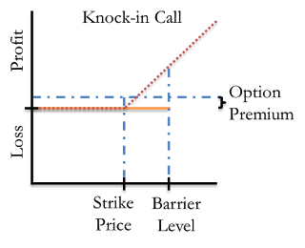
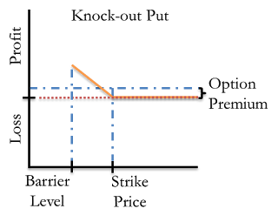
III-Barrier Options

Slide 8
IV-Partial-Time Barrier Options
The behavior is modified by the addition of a trigger window.
It is monitored for hits only during specific points in time.
That means the barrier is inactive for part of the option's lifespan.
The monitoring period can be at the beginning section or the end section of the option's life.
Two distinct types:
partial-time start options, which have a knock-out barrier at the beginning of the option's life that is removed at some preset point in time
partial-time end options (or protected barrier options), which cannot be knocked out at the beginning of their lives.
Notes:
These are similar to regular barrier options, the difference being that the the barriers can only be knocked in/out within a predefined period, and not over the whole life of the option.

Slide 9
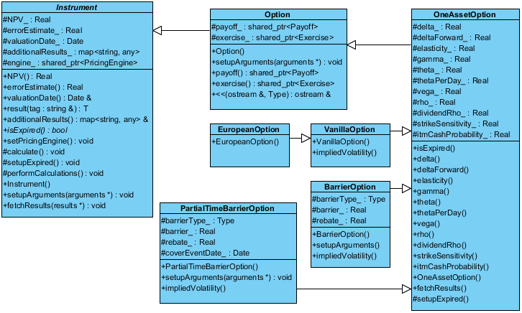
III-Barrier Options

Slide 10
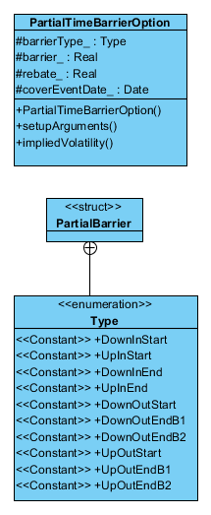
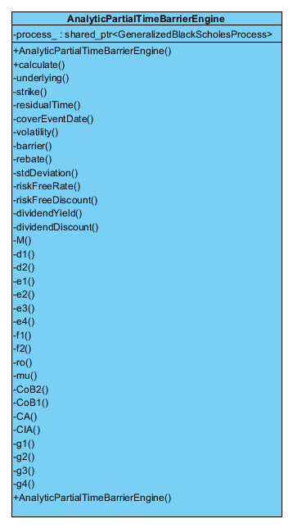
III-Barrier Options

Slide 11
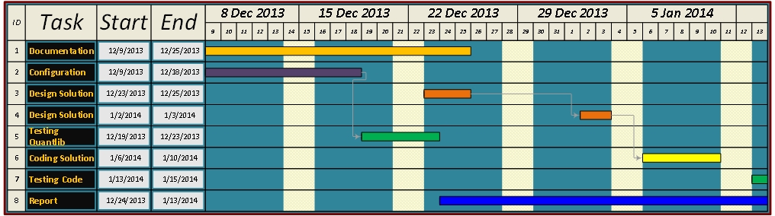
V-Work flow

Slide 12
Thank You ☺
Questions

